Slide 1

Economic Development
Thirteenth Edition
Chapter 5
Poverty, Inequality, and Development

Slide 2
Omissions
Omit: functional distributions, calculating the poverty headcount and Foster-Greer-Thorbecke index, Dualistic Development, details of Multi-Dimensional Poverty Index. Omit the appendix
As always refer to these class notes.

Slide 3
No society can surely be flourishing and happy, of which by far the greater part of the numbers are poor and miserable. (Adam Smith , 1776)
Viewed through the lens of human development, the global village appears deeply divided between the streets of the haves and those of the have-nots. (Human Development Report, UN, 2006)

Slide 4
Distribution and Development: Eight Critical Questions
How can we best measure inequality and poverty?
What is the extent of relative inequality in developing countries; how is this related to the extent of poverty?
Who are the poor, and what are their economic characteristics?
What determines the nature of economic growth—that is, who benefits from economic growth, and why?

Slide 5
Distribution and Development: Eight Critical Questions (Continued)
Are rapid economic growth and more equal income distribution compatible or conflicting objectives? Is rapid growth achievable only at a cost of greater income inequality or can lessening income disparities contribute to higher growth rates?
Do the poor benefit from growth, and does this depend on the type of growth a developing country experiences? What might be done to help the poor benefit more?
What is so bad about extreme inequality?
What kinds of policies are required to reduce the magnitude and extent of absolute poverty?

Slide 6
A Capabilities and Distribution-Based Social Welfare Framework
Placing Chapter 5 in the development and capabilities framework of Chapter 1…
Generally, we may think of welfare as a function, W = W(Y, E, H, M, Other…),
Where Y=standard of living, E=Education, H=Health, M=Empowerment, and Other represents additional factors representing important capabilities
Income, health, education indicators are averages; but distribution also matters

Slide 7
In chapters 3 and 4, we focus most on Y (income, or permanent income from wealth, or broadly living standards), through frameworks such as:
Growth models
More complex constraints on growth including coordination failures
Growth diagnostics
In chapters 3 and 4, we used average incomes, Y, as the outcome variable

Slide 8
A Capabilities and Distribution-Based Social Welfare Framework (Continued)
Here, we first consider distribution of Y, expanding from averages to address:
(Relative) Inequality of Income
(Absolute) Income Poverty
In the first part of Chapter 5, our welfare framework becomes:
W = W(Y, I, P)
Then we study multidimensional poverty with three deprivations: in health, education, and income (or assets)
In Chapter 8 we examine health and education inequality

Slide 9
According to the World Bank Global Poverty Update April 2022(estimates)
Approximately 8.6% of the world population lives under $1.90 per day vs. 36% in 1990.
Approximately 23.2% lives under $3.20 per day vs. 55.3% in 1990
Approximately 42.9% lives under $5.50 per day vs. 67.1% in 1990
(note old standards were $1-1.25 a day and $2 a day)
Inequality and poverty are present in ALL countries;
developed and developing. Note: rising inflation and the economic impacts of COVID-19 could reverse this trend. Source: https://blogs.worldbank.org/opendata/april-2022-global-poverty-update-world-bank

Slide 10
5.1 Measuring Inequality and Poverty
Measuring Inequality
Size distributions (quintiles, deciles): shows amount of income received by various classes of families or individudals. (we usually use household income)
Lorenz curves
Gini coefficients and aggregate measures of inequality

Slide 11
Desirable Properties for Measures of Relative Inequality
Anonymity: measure should not depend on who has higher income; e.g. whether we believe the rich or poor to be good or bad people
Scale independence: inequality measures should not depend on size of the economy – want a measure of income dispersion
Population independence principle: an inequality measure should not be based on the number of income recipients
Transfer principle - all other incomes constant, if transfer income from a richer to a poorer person (not so much that the poorer person is now richer than the originally rich person), resulting new income distribution is more equal
Gini coefficient satisfies all four properties.

Slide 12
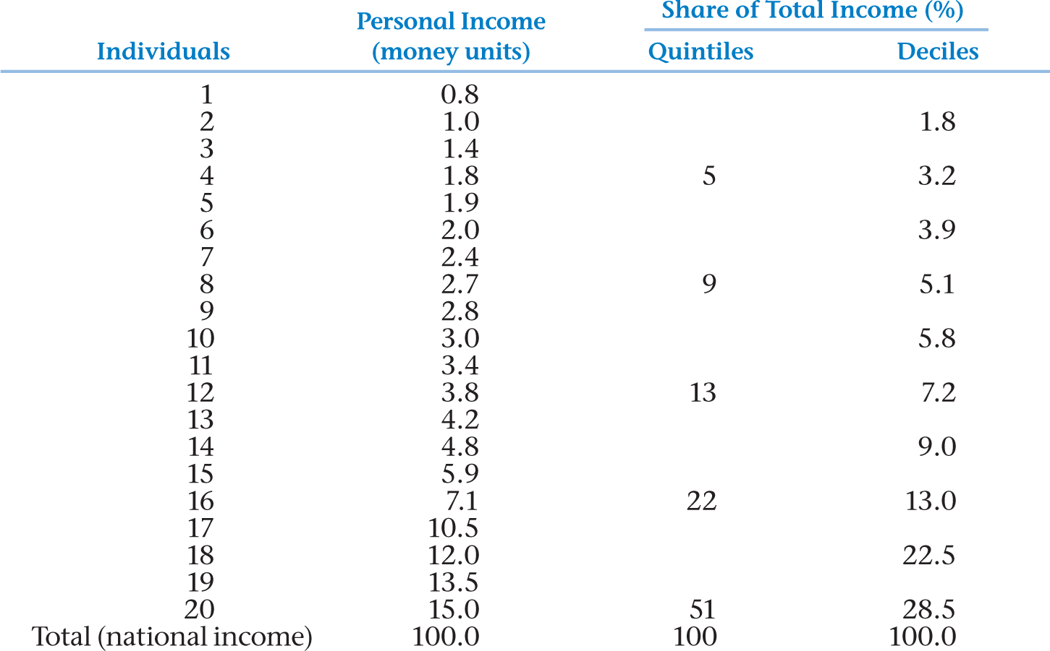
Table 5.1 Typical Size Distribution of Personal Income in a Developing Country by Income Shares—Quintiles and Deciles

Slide 13
Cumulative % of Income
The Lorenz Curve
100
45 degree
Line =
Perfect
equality
Perfect
Inequality
Area A
Area B
100
Cumulative %
Of Recipients
Notes:
Closer to 45 degree line, it is closer to equality
Gini Coefficient = A/(A+B), lower is better

Slide 14
If everyone had the same income, the Lorenz curve would equal the 45 degree line.
Inequality increases as the Lorenz curve bends away from the 45 degree line (leading to the area A getting larger).
A/(A+B) = Gini coefficient
Where A represents the area between the 45 degree line and the Lorenz curve and area B represents the area between the Lorenz curve and the outside of the box.

Slide 15
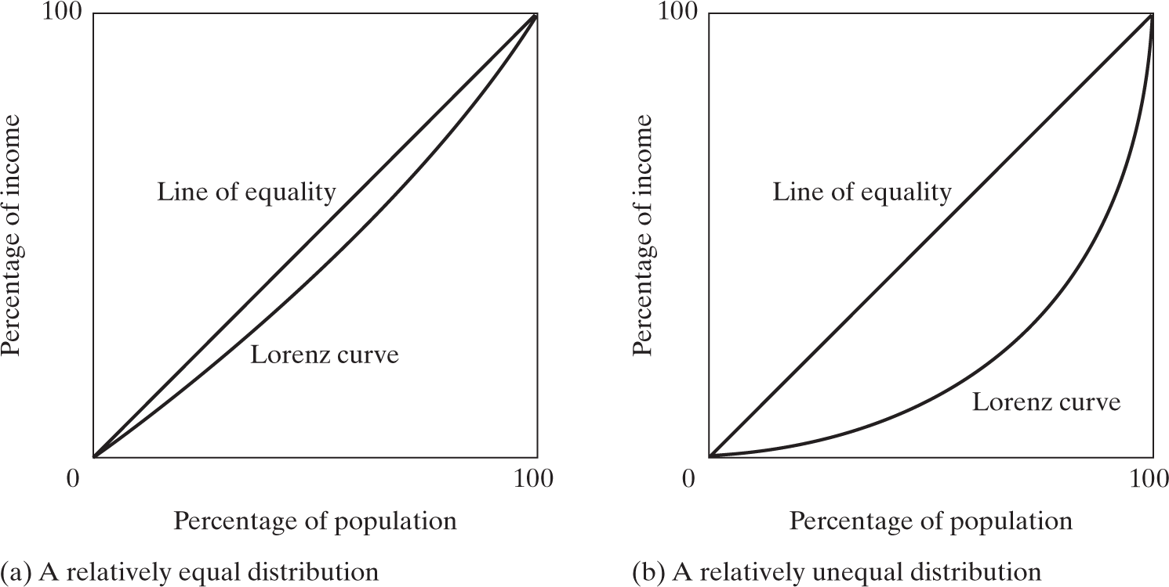
Figure 5.2 The Greater the Curvature of the Lorenz Line, the Greater the Relative Degree of Inequality
Notes:
The left one is better.

Slide 16
The Gini Coefficient
Equation= value of area A
Value of area A + B
It will range from a value of 0 (perfect equality) to a value of 1 (perfect inequality)
Note that the value of area A + area B always equals 0.5.

Slide 17
Sample Gini Coefficients
Relatively Low
- Egypt, Cambodia, Croatia
Relatively High
Zambia, Iran, Malaysia, Brazil
South Africa, the US
https://worldpopulationreview.com/country-rankings/gini-coefficient-by-country

Slide 18
Problems with using the Gini and the Lorenz curve:
1) Lorenz curves can intersect
2) Curves with different shapes can generate the same Gini ratio.
3) the measure is fairly sensitive to the distribution changes

Slide 19
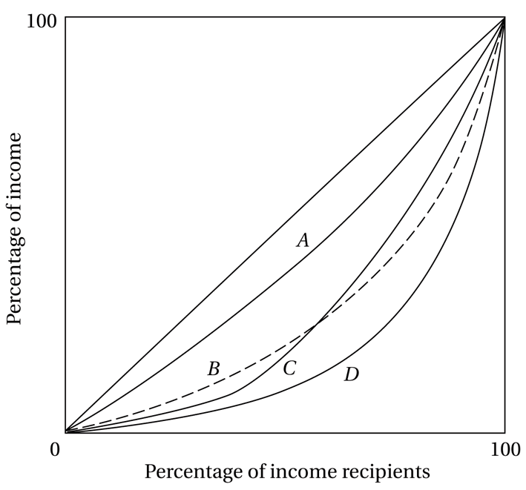
Figure 5.4 Four Possible Lorenz Curves
Curve A=
Most equal
Curve D=
Least equal
What about
The other 2?

Slide 20
Monotonicity and Distributional Sensitivity
Monotonicity principle: If you add income to someone below the poverty line, all other incomes held constant, poverty falls
Distributional sensitivity principle: if you transfer income from a poor person to a richer person (even if the “richer” person is also below the poverty line), the resulting economy is deemed strictly poorer
These principles clarify what is lacking in some widely used measures such as the simple headcount and headcount ratio

Slide 21
5.2 Measuring Absolute Poverty
Headcount Index: H/N
Where H is the number of persons who are poor and N is the total number of people in the economy; H/N is the fraction who are poor
Does not meet desirable properties and accordingly is likely to cause incentive problems.

Slide 22
Unintended Policy Incentives of Using Headcount Measures
When agencies are told their mission includes poverty reduction…
Measuring poverty by headcount or fraction poor creates incentive to report improvements in these measures; this plausibly focuses efforts toward those closer to poverty line
Circumstantial evidence:
Incumbent politicians frame poverty progress in terms of headcount or fraction – staff would anticipate and want favorable results - by this measure - to report
Government policy exhibits “urban bias,” e.g. emphasizing job creation for the poor in cities - who are closer to the poverty line
Reports: NGOs work near main roads, or district towns, easier-to-reach; if so, people assisted are less poor on average
Notes:
If the city goes worse, then possibly rural areas also goes aores.

Slide 23
5.2 Measuring Absolute Poverty
Total poverty gap:
Where Y_{p} is the absolute poverty line; and Y_{i} the income of the ith poor person (note we will not calculate this or the Foster-Greer-Thorbecke Index). Measures the extent to which each person’s income falls below the absolute poverty line…

Slide 24
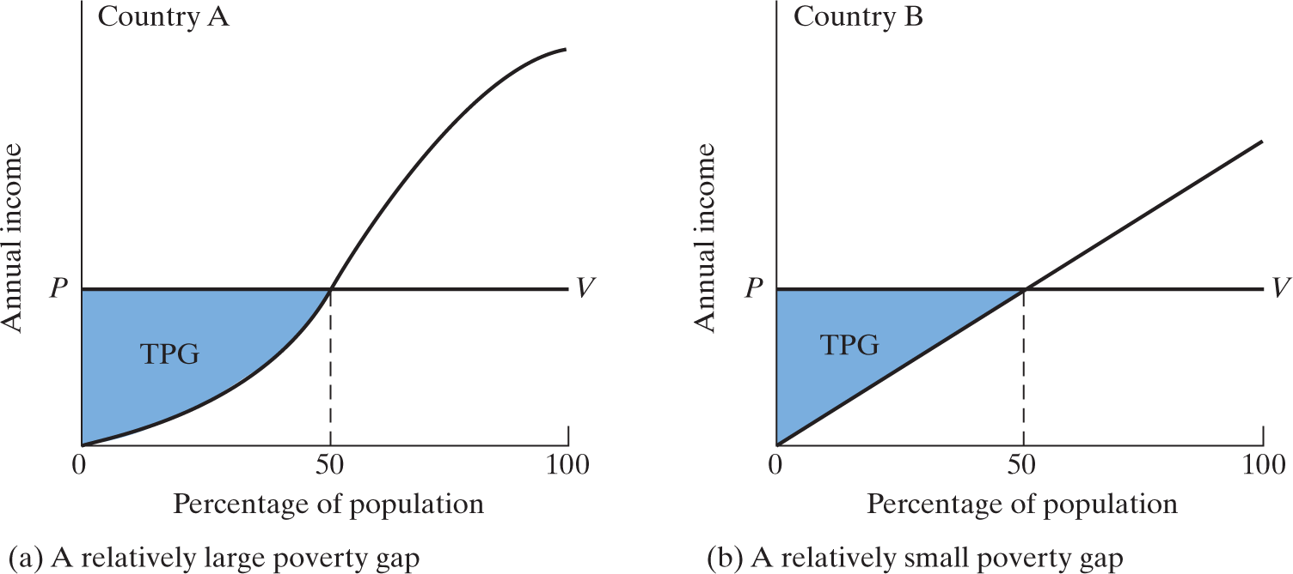
Figure 5.5 Measuring the Total Poverty Gap

Slide 25
5.2 Measuring Absolute Poverty
Average poverty gap (APG):
Where N is number of persons in the economy
TPG is total poverty gap
Note: normalized poverty gap, NPG = APG/Y_{p}

Slide 26
5.2 Measuring Absolute Poverty (Continued)
Measuring Absolute Poverty
Average income shortfall (AIS):
Where H is number of poor persons
TPG is total poverty gap
Note: Normalized income shortfall, NIS = AIS/Y_{p}
Notes:
Inequality, poverty number, what casus poverty

Slide 27
5.2 Poverty, Inequality, and Social Welfare
What’s So Bad about Extreme Inequality?
Note that this can be due to very few people at the top who are very rich and/or a lot of people at the bottom who are poor
What are the economic arguments?
Notes:
Band about extreme inequality:
Inequality is not all bad: for those who are rich,

Slide 28
Why is inequality bad?
- Income inequality usually leads to economic inefficiency
- Relative poverty leads to low credit rating: savings lower, less investment,
- The rich tend to invest abord
- Inequality can lead to social unrest

Slide 29
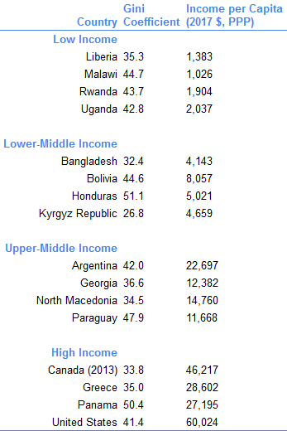
Source: World development indicators.

Slide 30
Poverty, Inequality, and Social Welfare
Dualistic Development and Shifting Lorenz Curves: Some Stylized Typologies
Traditional sector enrichment (see Figure 5.6)
Modern sector enrichment (see Figure 5.7)
Modern sector enlargement (see Figure 5.8)
Note: there is an “interaction effect” between modern sector enlargement and enrichment (if someone moving to the modern sector also gets the modern sector “raise” received by those already in that sector…)

Slide 31
Traditional Sector Enrichment
All of the benefits of growth are divided among traditional sector workers with little or no growth in the modern sector.
Eg. Policies focusing on decreasing absolute poverty with relatively low growth rates
Lead to a reduction in inequality
Notes:
Factories: more efficient, raising the bottom, so the inequality is better

Slide 32
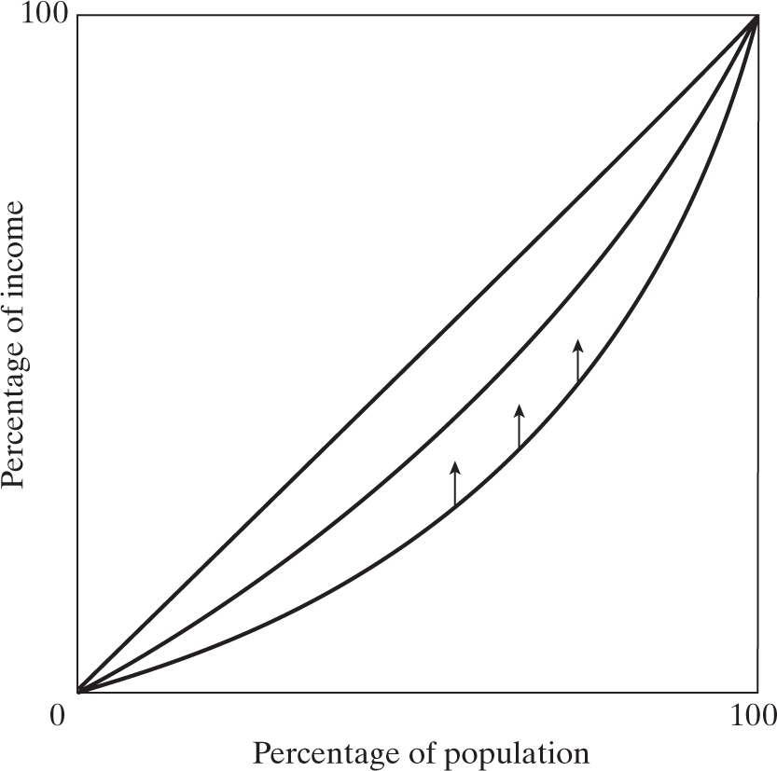
Figure 5.6 Improved Income Distribution under the Traditional-Sector Enrichment Growth Typology

Slide 33
Modern Sector Enrichment
Growth is limited to a fixed # of people in the modern sector and in the traditional sector, both wages and number of workers remain constant.
Leads to inequality rising.

Slide 34
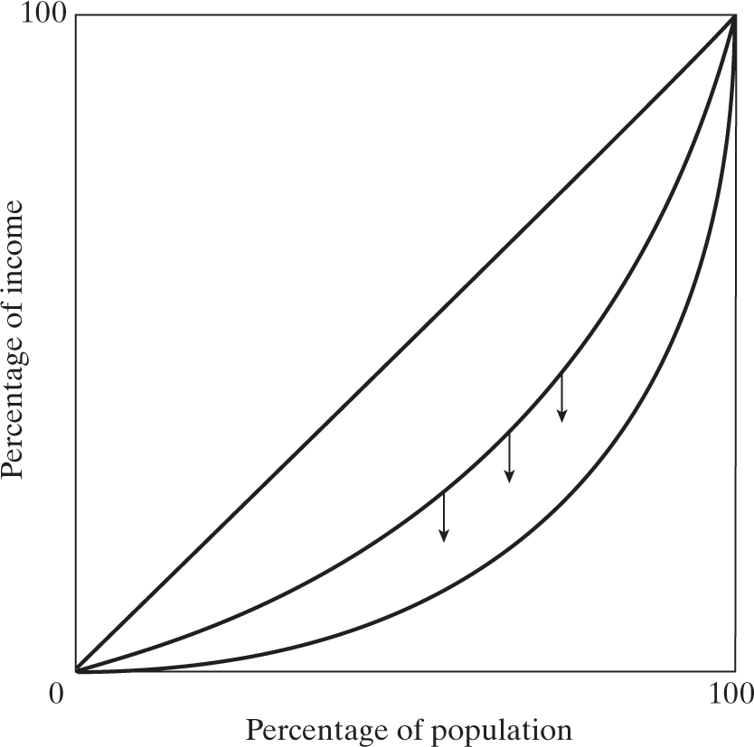
Figure 5.7 Worsened Income Distribution under the Modern-Sector Enrichment Growth Typology
Notes:
We only making the top more efficient, so the gap is wilder, and the inequality is worse.

Slide 35
Modern Sector Growth
Enlarging the size of the modern sector with wages being relatively constant in both sectors
Viewed as Lorenz curves crossing
Inequality remains almost the same
Notes:
not necessarily works
Wage stays the same

Slide 36
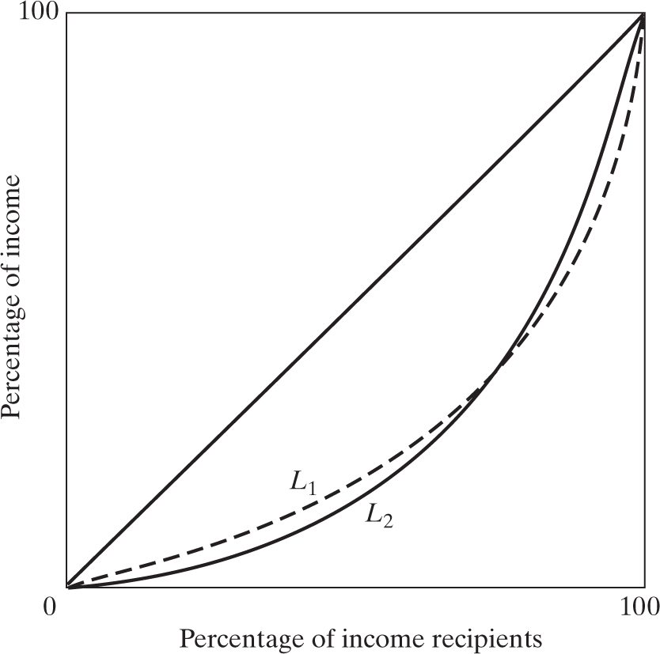
Figure 5.8 Crossing Lorenz Curves in the Modern-Sector Enlargement Growth Typology
Poverty decreases
A little in L₁ and increases
A little in L₂
Notes:
From l2 to l1: for those who having lower income, they could have more money, but for those who are rich, case is at the other side. But the Gene keeps almost the same.

Slide 37
5.3 Poverty, Inequality, and Social Welfare
Kuznets’ Inverted-U Hypothesis- inequality gets worse before it gets better
Why?
Is this inevitable?
The inverted-U could be consistent with modern sector enlargement growth, but not traditional or modern sector enrichment growth, depends if there is eventually positive trickle down effects

Slide 38
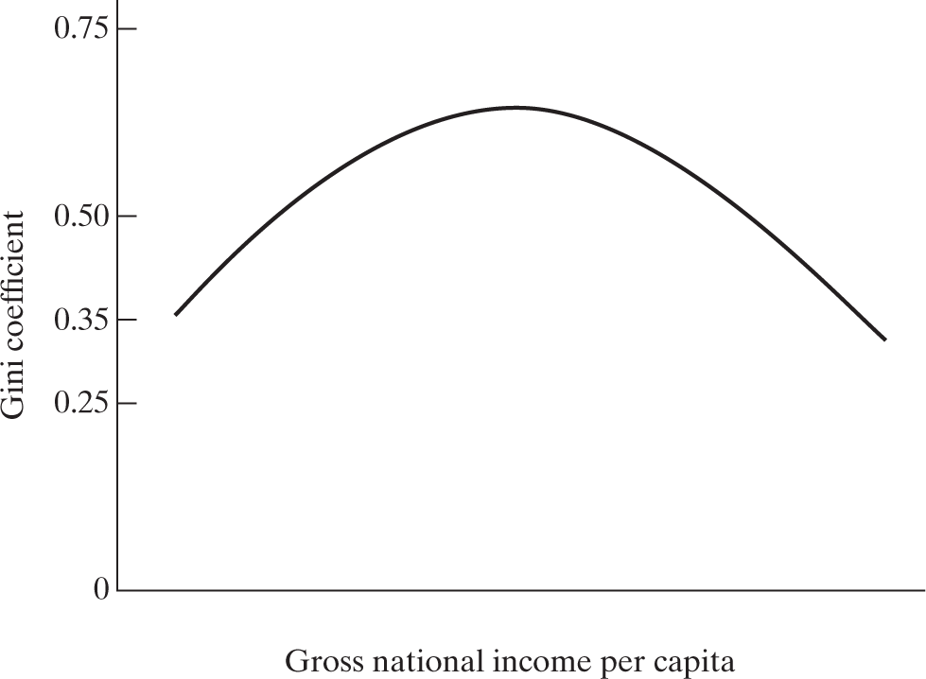
Figure 5.9 The “Inverted-U” Kuznets Curve
Notes:
My country grows, government focus upper sectors, so the upper is getting better,

Slide 39
What’s good about inequality?
Could reflect real GDP growth
Create incentive for risk taking (worthy)

Slide 40
5.4 Absolute Poverty: Extent and Magnitude.
Progress on Extreme Poverty
Clear progress on $1.25-a-day headcount (old standard, now $1.90)
Less progress on $2.00-per-day headcount (see Figure 5.14) (old standard, now $3.20)
Incidence of extreme poverty is uneven
Relationship between Growth and Poverty
Association between growth and poverty reduction
When it is inclusive, growth reduces poverty
Lower extreme poverty may also lead to higher growth

Slide 41
Poverty Measures
Basic Human Needs (BHN) and Social Indicators
rather than just looking at income, look at minimum levels of nutrition, health, clothing, etc.

Slide 42
Basic Human Needs (BHN) Policies
BHN emphasizes the provision of public services, along with entitlements to the poor to make sure they get access to the service provided.
Basic commodities: staple foods, water and sanitation, health care, primary and nonformal education and housing

Slide 43
Relationship between Growth and Poverty
Association between growth and poverty reduction
When it is inclusive (spread fairly equally), growth reduces poverty
Lower extreme poverty may also lead to higher growth
Research suggests that approx 1/3 of the poor are always poor.

Slide 44
Inequality can also reduce growth
How?

Slide 45
Ultra poverty differs in terms of depth, length and breadth (how many variables affected)
Growth can lead to poverty and
decreasing poverty can lead to growth

Slide 46
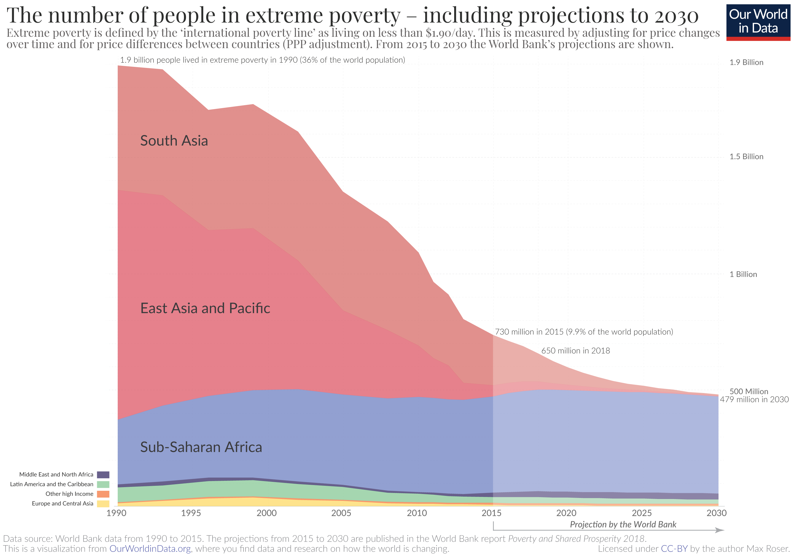

Slide 47
Figure 5.12
Global and Regional Poverty Trends, 1981–2015

Slide 48
Multi-Dimensional Poverty Index
The MPI incorporates 3 dimensions at the household level: health, education and wealth
- takes into account negative interaction effects when people have multiple deprivations (similar to the HDI)
MPI focuses on deprivations in health, education, and standard of living; and each receives equal (that is one-third of the overall total) weight.

Slide 49
Social exclusion/injustice, associated with poverty, likely causes economic stagnation
Social exclusion/injustice, which is associated with poverty, also likely causes economic stagnation in the long run
Political and social reform needed to overcome constraints to access to land, water, basic resource-based livelihood opportunities
Elite control of natural resources translates to social and political power to protect elite interests that may be inconsistent with modernization
Inadequate voice for the poor who know their public goods needs

Slide 50
5.5 Economic Characteristics of High-Poverty Groups
Rural poverty
Women and poverty
Ethnic minorities, indigenous populations
Disproportionately children
Malnourished, less likely to receive medical services, clean water, sanitation
Less access to education, property rights

Slide 51
Empirically
Empirically we tend to see rapid growth (over 5%) benefiting both the poor and nonpoor and we see economic decline affecting both the poor and nonpoor (in terms of income). However, there are exceptions = immiserizing growth.
How do you think this might be possible?

Slide 52
Labor and Inclusive Development: The Quality of Jobs
Most people receive income primarily from labour, that is, from the work that they do
Approximately 3.3 billion people currently work
But having work does not mean having a wage
In most developing countries, a minority of labour income is from conventional “jobs”
Close to half engaged in self-employment
Wage labour often low-productivity work, with irregular incomes
Thus, high inequality in labour markets can serve to magnify other forms of inequalities

Slide 53
The Broad Importance of High- Quality Jobs
The type of work a person does largely constrains their possibilities of getting future higher income
Broadly, jobs help people gain and maintain capabilities
Skills and attitudes people develop at jobs affect [how others perceive] their capabilities in other spheres
People with jobs that develop multiple capabilities are more engaged in civic affairs

Slide 54
Policies and Programs
Policy can:
Reduce constraints on job creation, such as building needed infrastructure,
Ensure incentives do not hinder quality job creation
But reforming some laws – and even more so norms – is more difficult
Example: those discouraging women from working
Programs for employment when jobs are scarce can help, but need careful design and implementation

Slide 55
5.6 Policy Options on Income Inequality and Poverty: Some Basic Considerations (Continued)
Policy options
Changing relative factor prices (labour vs. capital)
Progressive redistribution of asset ownership
Progressive taxation (eg. tax rates and wealth taxes)
Transfer payments and public provision of goods and services
A focus on workfare vs welfare programs

Slide 56
Improving Opportunities for the Poor
1) The Goal of Expanding basic education and health services
→ improves productivity
→ increases opportunities and improves literacy

Slide 57
2) Rural infrastructure improvements
- rural agricultural supports (as most of the population live in rural areas)
Eg. Building new roads

Slide 58
Income Transfers and Safety Nets
3) Food subsidization/distribution/price ceilings
This helps as it lowers the price paid BUT one problem is the

Slide 59
Other Types of Gov’t Policies and/or Goals
1) Measures to make labour cheaper relative to capital, leading to Labour increasing.
How could we do this?
2) Dynamic redistribution of assets by encouraging those which the poor can own, such as improved agricultural land or small shops
Microfinance is one option, what else?

Slide 60
Cont’d
4) More progressive taxation, tax breaks, subsidies
5) Public (gov’t) provision of consumption goods, such as basic foods
6) Intervention in commodity markets to aid poor producers and consumers. HOW?
7) Development of new technologies which improve productivity of low income workers.
8) Minimum wages: specific policy but increases the price of labour
Think of advantages and disadvantages of these policies. Which would you recommend?

Slide 61
Many LDCs collect at least 20% of GDP in gov’t revenue
Tax Systems can be less
Indirect Taxes can be somewhat

Slide 62
Workfare vs Welfare? Basic cost effectiveness considerations
Workfare, such as a Food for Work Program, are more likely to represent a better policy than welfare on a current program efficiency basis when these criteria are met:
It is harder to screen the poor without a workfare requirement
Poor workers have lower opportunity cost of time (so the economy loses little output when they work in the program)
Non-poor workers have higher opportunity cost of time (so they are unlikely to participate to get the benefits)
The fraction of the population living in poverty is smaller (so the extra costs of a universal welfare scheme would be high)
Note: Each of the above are factors in the efficiency tradeoff:
All these factors must be accounted for together to determine whether welfare or workfare is comparatively more efficient

Slide 63
Applying Insights from Behavioral Economics to Address Poverty
Research findings: “Cognitive Tax of Poverty”
Impact of poverty on anxiety and mental illness
Implications for program design

Slide 64
A Hidden “Cognitive Tax of Poverty”
Cognitive challenges increase with stress
For the poor, sources of stress include financial worries, persistent noise, air pollution, disrupted sleep, chronic pain
Stress and environment-linked deficits in cognitive functions include focused internal and external attention, inhibitory control, cognitive flexibility, planning

Slide 65
Rich nations need to do more to alleviate poverty
How?

Slide 66
Sachs, End of Poverty quote
The greatest tragedy of our time is that about 1/6 of humanity is not even on the development ladder. A large number of the extreme poor are caught in a poverty trap, unable on their own to escape from extreme material deprivation.
They are trapped by disease, physical isolation, climate stress, environmental degradation and by extreme poverty itself.

Slide 67
Even though life-saving solutions exist ….these families and their governments simply lack the financial means to make these critical investments.
The world’s poor know about the development ladder: they are tantalized by images of affluence from halfway around the world. But they are not able to get a first foothold on the ladder, and so cannot even begin the climb out of poverty.
Source: Jeffrey Sachs, “The End of Poverty: economic possibilities for our time”, New York: Penguin Press, 2005, p. 19-20.

Slide 68
Concepts for Review
Absolute poverty
Asset ownership
Character of economic growth
Disposable income
Factor share distribution of income
Factors of production
Gini coefficient
Income inequality
Indirect taxes
Kuznets curve

Slide 69
Concepts for Review (Continued)
Lorenz curve
Multidimensional poverty index (MPI)
Personal distribution of income
Progressive income tax
Public consumption
Redistribution policies
Regressive tax
Size distribution of income
Subsidy
Total poverty gap (TPG)
Workfare programs

